Slide 1
Using PINN’s to simulate beam behaviour
By Amco, Bastiaan, Daan, Hidde and Jur
BEAM2

Slide 2
Why we use PINNs?
Main goal: Prediction of complex engineering problems
Key advantages:
Data-driven learning
Reduced computational costs
Challenges:
Incorporating physics
Loss function design
Training stability

Slide 3
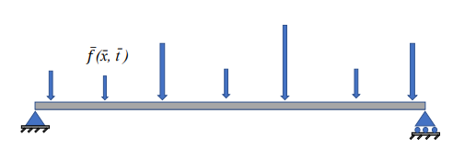
Problems
Euler-Bernoulli forward problem
-> Build PINN to accurately predict deflection
-> Check accuracy of velocity,
acceleration and bending moment
Timoshenko forward problem
-> Build and train PINN to predict θ and w
Timoshenko inverse problem
-> Build and train PINN to predict f alongside
θ and w using observations

Slide 4
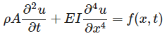
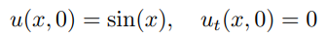
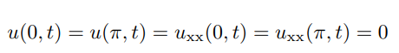
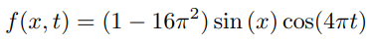
Euler-Bernoulli beam
Non-dimensionalized
Partial Differential Equation (PDE)
4 boundary and 2 initial conditions
Dynamic forcing term
Goals:
Part 1.1 and 1.2: Predict deflection and obtain high accuracy
Part 1.3: Bending moment, velocity, acceleration

Slide 5
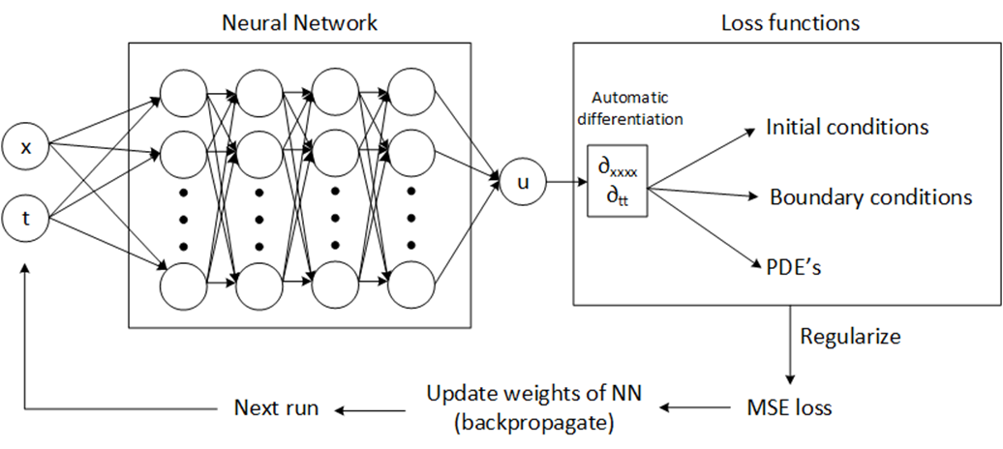
Method
MLP
tanh activation function
4 hidden layers
25 neurons per layer
Xavier initialisation
LBFGS optimiser
Loss = λ₁* initial + λ₂* boundary + λ₃*physics

Slide 6
Training input
Initial points: 500
Left boundary points: 500
Right boundary points: 500
Residual points: 2000

Slide 7
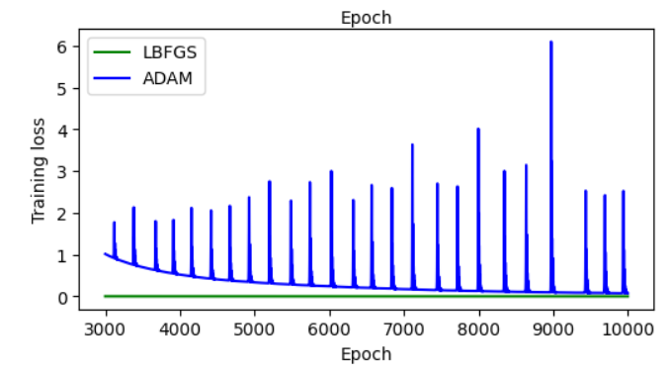
Hyperparameters
Activation function
Optimiser
Epochs 14000
Learning rate 0.1
λ₁ = 1, λ₂ = 1, λ₃ = 0.1

Slide 8
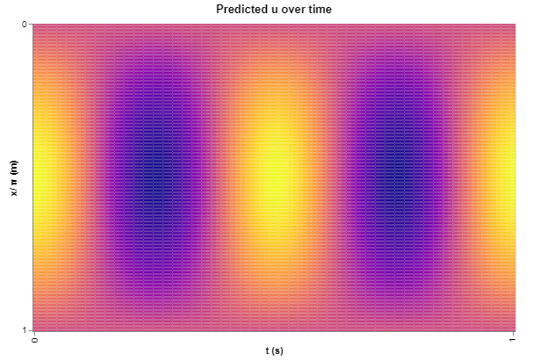

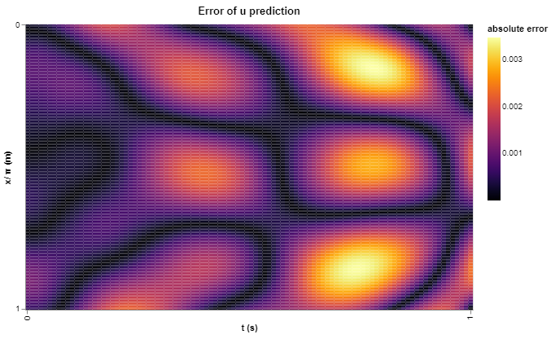
Results

Slide 9
Results

Slide 10
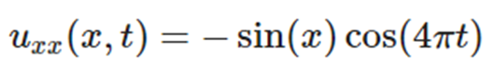
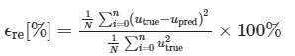
Differentiated values
Bending moment (u_{xx})
Velocity (u_{t})
Acceleration (u_{tt})
Relative error
 | Relative error
Deflection | 0.00015%
Bending moment | 0.02649%
Velocity | 0.00011%
Acceleration | 0.00009%

Slide 11
Results

Slide 12
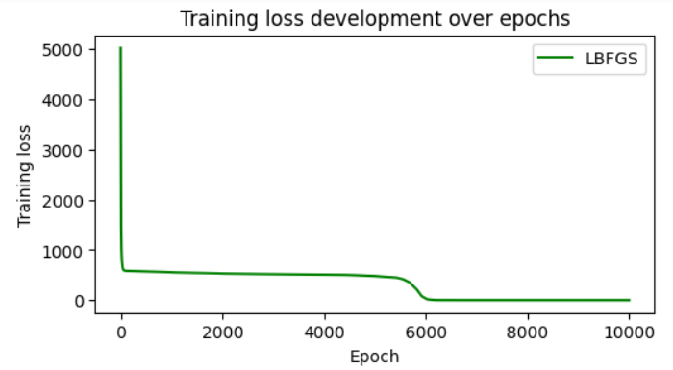
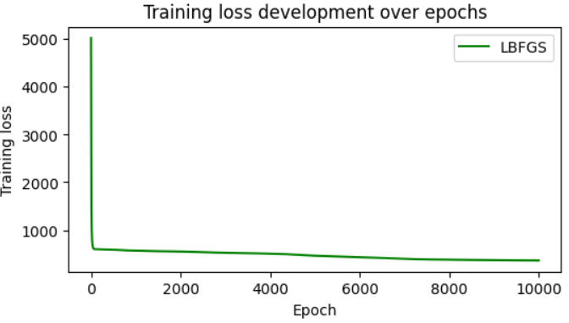

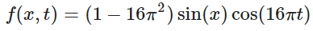
Limitation of PINNs
Spectral bias of NN
Problems with high frequencies
Loss after 10000 epochs: 365

Slide 13
Timoshenko beam
Part 1 (forward problem):
Predict exact solutions for rotation and deflection
Part 2 (inverse problem):
Use previously trained PINN to generate “sensor observations” for rotation and deflection
Inversely predict forcing on the beam, using these observations
Optimise the amount of sensors and their locations

Slide 14
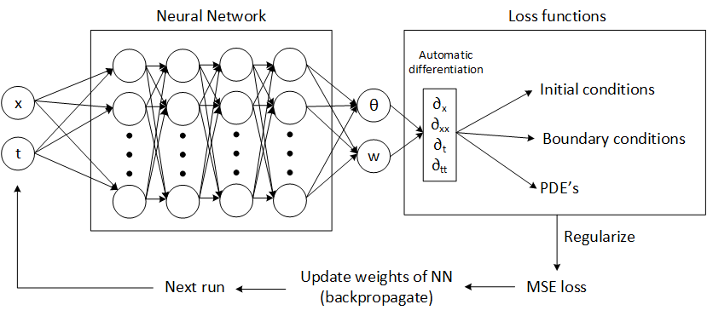
Method (forward problem)
Notes:
Neural network outputs theta and w
Loss function uses torch autograd to differentiate and IC’s, BC’s

Slide 15
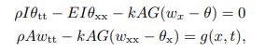
Method (forward problem)
Two coupled Partial Differential Equations (PDE’s)
Non-dimensionalized
Eight boundary and initial conditions
Dynamic forcing term

Slide 16
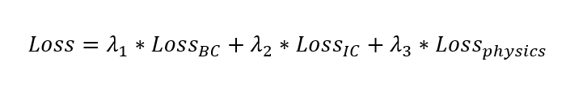
Hyperparameters
MLP (4 layers, 20 features)
Activation function: Hyperbolic tangent
Optimiser: LBFGS
Epochs 10000
Learning rate 0.1
λ₁ = 1, λ₂ = 1, λ₃ = 0.1

Slide 17
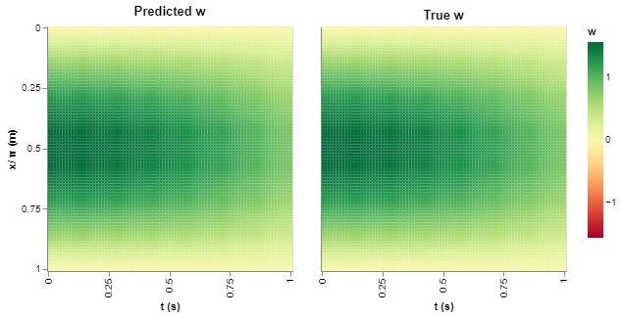
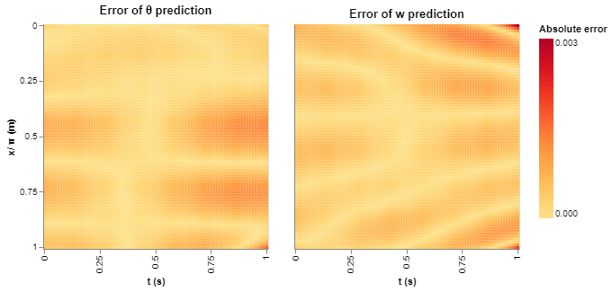
Results Timoshenko forward

Slide 18
Results Timoshenko forward

Slide 19
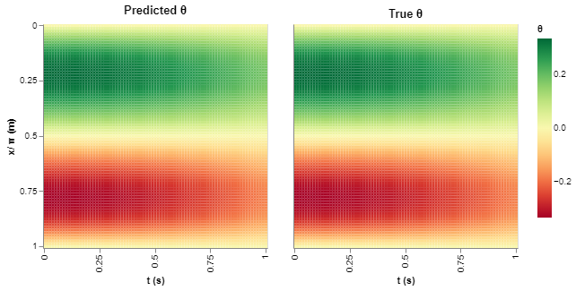
Results Timoshenko forward

Slide 20
Results

Slide 21
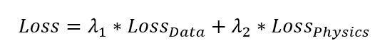
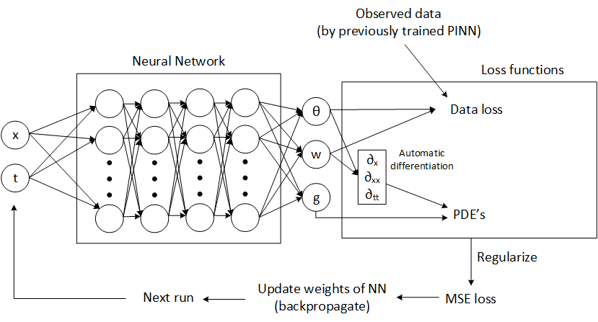
Method (inverse problem)
Two coupled Partial Differential Equations (PDE’s)
Predict dynamic forcing term alongside theta and w
Loss is a function of observations and physics ->

Slide 22
Hyperparameters
Obtained from empirical testing and literature
Assumptions for optimisation
MLP (4 layers, 20 features)
Activation function: Hyperbolic tangent
Optimiser: LBFGS
Epochs 15000
Learning rate 0.1
λ₁ = 1, λ₂ = 0.05
Assumed sensor sampling rate of 1000 /s
Sensors fixed at their locations -> to be optimised

Slide 23
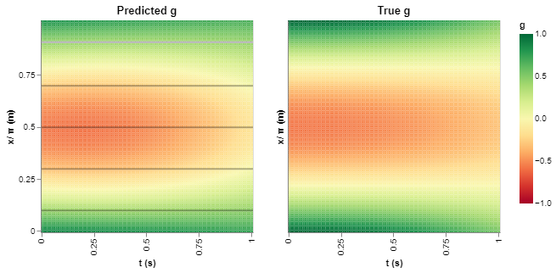
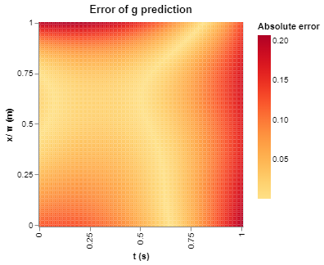
Results before sensor optimisation

Slide 24
Results before sensor optimisation

Slide 25
Optimisation sensor placement algorithm
Run model with linear spaced multiple times with N = 2 to N=15
Calculate relative error for every model
Get the model with least amount of sensors for which error < 10%
Optimise location of this model empirically by looking at error

Slide 26
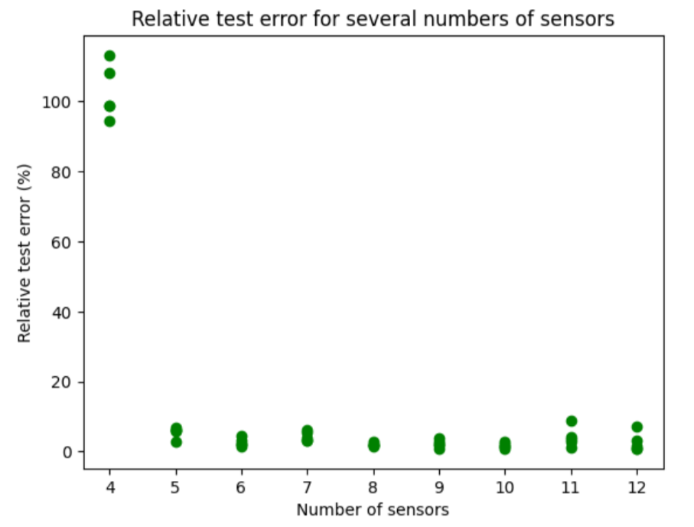
Optimisation amount of sensors

Slide 27
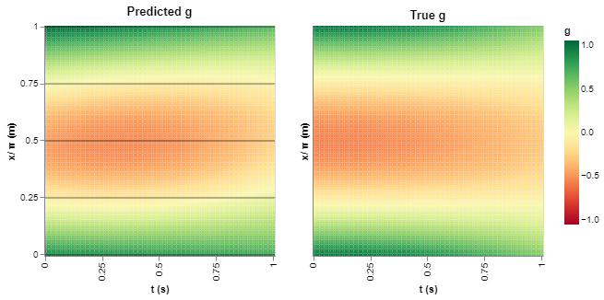
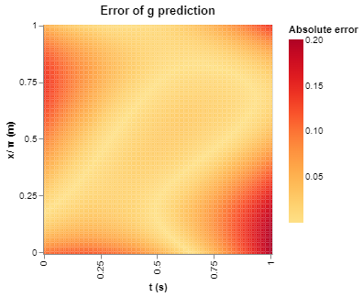

Results optimisation
Amount of sensors = 5
Placed on boundaries and linearly spaced in between
Other placings of sensors are tried but no benefit is found

Slide 28
Results final estimate of g(x,t)
Not as accurate as w and θ
G is less represented in the loss function as θ and w

